Slide 1
BRAND GUIDELINES

Slide 2
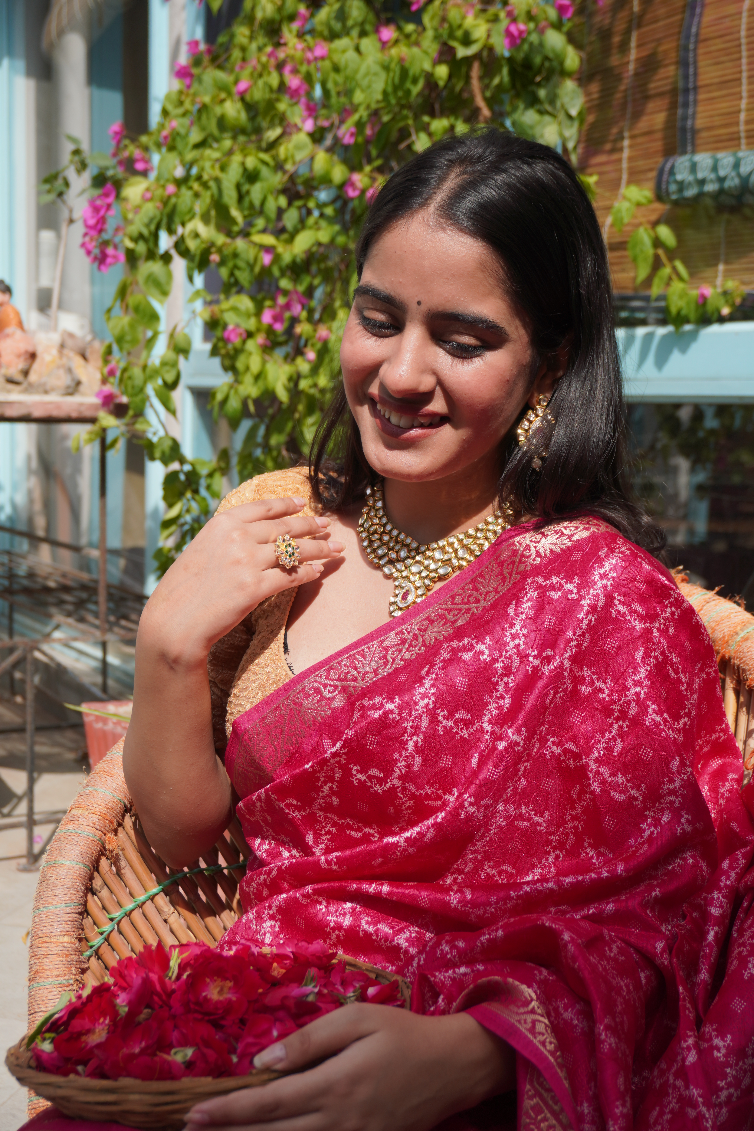
ABOUT US

Slide 3
ABOUT US
VISION OF ISHORI
“our vision is to make every women feel beautiful and confident in a saree – a symbol of Indian tradition and timeless grace. Ishori aims to enhance and preserve the beauty of Indian culture through our traditionally rooted sarees , crafted with love and offered at an affordable price . We dream of a world where every women proudly wears the essence of india , draped in an ishori saree.”
MISSION OF ISHORI
“our mission is to keep Indian culture alive through the beauty of traditional sarees blended with modern , trending designs. At ishori , we strive to ensure that our rich heritage never fades amidst the wave of western fashion . Each ishori saree is crafted with love , care , and creativity – designed to make every women feel confident , graceful , and more beautiful . We aim to bring timeless elegance to every wardrobe at an affordable price , celebrating the essence of Indian womanhood through every drape.”

Slide 4
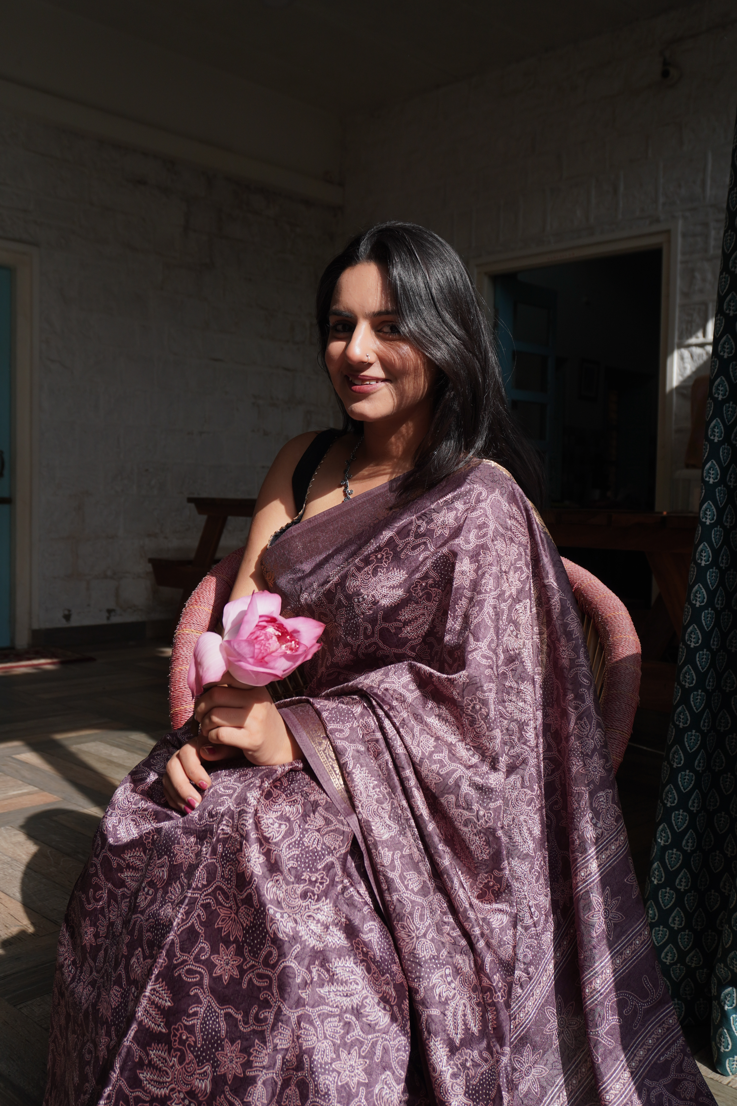
BRAND INTRODUUCTION
at ISHORI by Rakshit Bansal, we believe that fashion is not just worn — it’s felt. Every drape, every weave, and every fold tells a story — of grace, heritage, and timeless beauty. Ishori is a saree label where Indian tradition meets modern elegance, creating pieces that celebrate the soul of our culture while embracing the spirit of today’s woman.

Slide 5
BRAND IDENTITY
Ishori is a celebration of Indian tradition, elegance, and womanhood. Rooted in culture and crafted with grace, Ishori brings timeless sarees that blend heritage with contemporary charm. Every drape tells a story — of beauty, pride, and the soul of India.Ishori is not just a brand; it’s the essence of every woman who carries tradition with dignity and style.

Slide 6
OUR LOGO Ishori is an identity of divine feminity . Ishori is more than just a name, it is an identity. It is a spirit of the contemporary women- one who gracefully bridges the timeless beauty of tradition with the confidence of modernity. “ishori’s logo features a lotus , symbolizing grace,purity,and timeless beauty – reflecting the elegance and heritage woven into every saree we create”

Slide 7
VOICE TYPE 1. graceful 2. traditional yet contemporary 3. poetic and emotional 4. respectful and heartfelt 5. feminine and confident

Slide 8
A Message from the Founder Ishori is more than just a brand to me — it’s a dream woven with threads of tradition, love, and legacy. Having grown up amidst the beauty of sarees, I’ve always believed that every drape carries a story, a memory, and a reflection of our culture. With Ishori, my vision is to take this timeless heritage into the hearts and homes of women everywhere, blending tradition with modern grace.Every saree at Ishori is a promise — of authenticity, quality, and elegance. It is my way of honoring our artisans, celebrating our culture, and cherishing the women who make sarees come alive with their grace.I invite you to be a part of this journey, to celebrate tradition with us, and to experience the beauty of Ishori in every weave.“ — Rakshit Bhanshal Founder, Ishori

Slide 9
CONTACT INFORMATION
CONTACT US
connectishori@gmail.com
Website
www.ishori.com
PHONE
+918107708989

